Slide 1
APOLLO CSM ANTENNA SELECT MODEL
This model was used by the MCC MOCR “INCO” Operator
to determine the best CSM Omni Antenna to pass up to the
Crew for a given local vertical/horizontal spacecraft attitude.

Slide 2
The model was created to provide INCO a visual determination of which CSM Omni Antenna was in the best Line-of-Sight to the Manned Spacecraft Network Station (MSN) ground antenna.
The Local Vertical Local Horizontal Attitude (LVLH) of the Spacecraft to the center of the earth Look-Angle vector was provided by the MOCR Guidance Officer (GIDO).

Slide 3
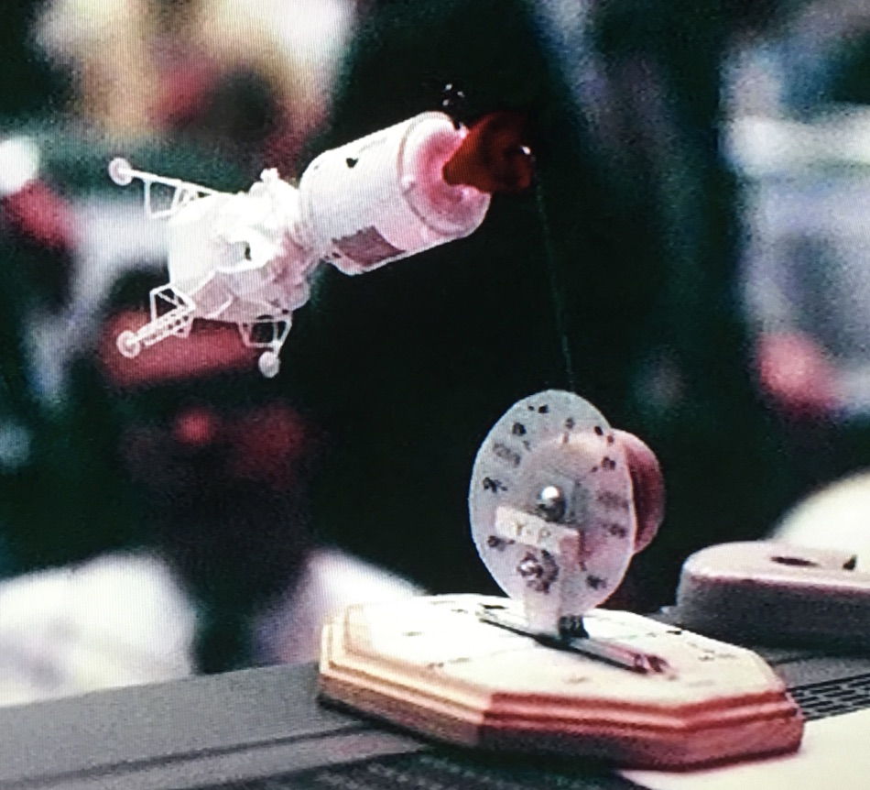
The LVLH Attitude is defined in Yaw (Y), Pitch (P) & Roll (R) angles of the CSM relative to the center of the earth . Note: The Y-P-R label on the Pitch Scale was made so that the correct sequence of the Y,P,R was assured in setting the model attitude.
YAW Scale (on model base) is labeled from (+180⁰⁾, yaw right to (0⁰),model straight forward, to (-180⁰) yaw full left.
PITCH Scale (vertical model scale) was labeled (+180⁰), pitch up, to (0⁰), model straight forward, to (-180⁰) pitch down.
ROLL Scale (model center axis was 0⁰ to 360^{0.}
The line of sight to the CSM was a perpendicular line from the model base to the CSM model. This represented the MSN Ground Station Look-Angel to the Spacecraft.
3
TL Hanchett, INCO, T6L22H2019

Slide 4
CSM MODEL SCALES & ANTENNA LOCATIONS
YAW is about the spacecraft’s z-axis, left (-) or right (+)
Range: -180 to 0 to +180.
Model Scale Markings: -180,-135,-90,-45, 0, +45, +90, +135, +180
PITCH is about the spacecraft’s y-axis, up (+) or down (-)
Range: -180 to 0 to +180.
Model Scale Markings: -180,-135,-90,-45, 0, +45, +90, +135, +180
ROLL is about the spacecraft’s x-axis
Range: 0 to 360.
Model Roll Scale Markings: No scale. 0 is Crew heads up. Roll increases from 0 for spacecraft roll right.
Note: Omni directions referenced to crew: A-right foot, B-left foot, C-left arm & D-right arm (counter clock-wise).

Slide 5
MODEL SETTINGS (example)
The picture on the left shows the model set at Yaw = 0, Pitch = 0 and Roll = 0.
This attitude would indicate a Line-of-Sight from a MSN Ground Station to the CSM directly between Omni Antennas “A” & “B”. Either one would be passed up to the Crew.
Note that the CSM Hatch is up and the crews head would be up indicating a Roll of 0. The High Gain Antenna would also be in view.

Slide 6
CONSTRUCTION OF THE MODEL
BASE ASSEMBLY
Octagon Wood Base - Michael's Arts & Craft Store/Hobby Lobby.
Base Scale - Use Circular Graph Paper. (online)
Make pointer from plastic – cut from food container cover.
Base post – Use a “L” shaped bracket as a post for Pitch Scale Assembly.
Add washers, nuts and wing nut to fasten “L” shaped bracket to the center of the base so the bracket rotates. Add Pointer to bracket.
ROLL AXIS WIRE
Bend a piece of wire of substantial strength (diameter) at a right angle and cut each leg to appropriate length.
Make a loop (eyelet) at one end of the wire the size of the wing nut screw in the pitch assembly.
The other end of wire will be inserted into the CSM SPS Engine Bell.
Use sticky tape labels at the four Omni Antenna locations.
PITCH SCALE ASSEMBLY
Circular Scale – Cut from plastic food container cover. Use clear sticky film for markings.
Find two wooden disks from Michael's Art & Craft Store/Hobby Lobby.
Thread a wing nut screw through top hole in “L” bracket, next thread on Pitch Scale, then attach the Roll Axis Wire looped end followed by another wooden Disk, and finish with wing nut.
Use screw and nut to fix Pitch Scale to “L” bracket so it won’t rotate.
Insert the other end of wire into the CSM SPS Engine Bell.

